Slide 1

Online Book Store Sales Analysis
Using
SQL
Javeria Khalid – Data Analyst

Slide 2
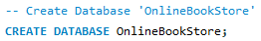
Create DataBase
Javeria Khalid – Data Analyst

Slide 3
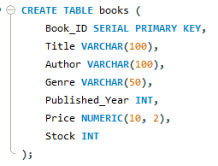
Create Table Books
Javeria Khalid – Data Analyst

Slide 4
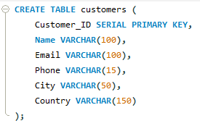
Create Table Customers
Javeria Khalid – Data Analyst

Slide 5
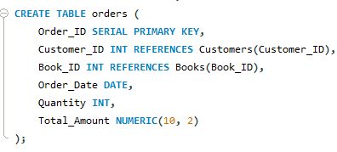
Create Table Orders
Javeria Khalid – Data Analyst

Slide 6
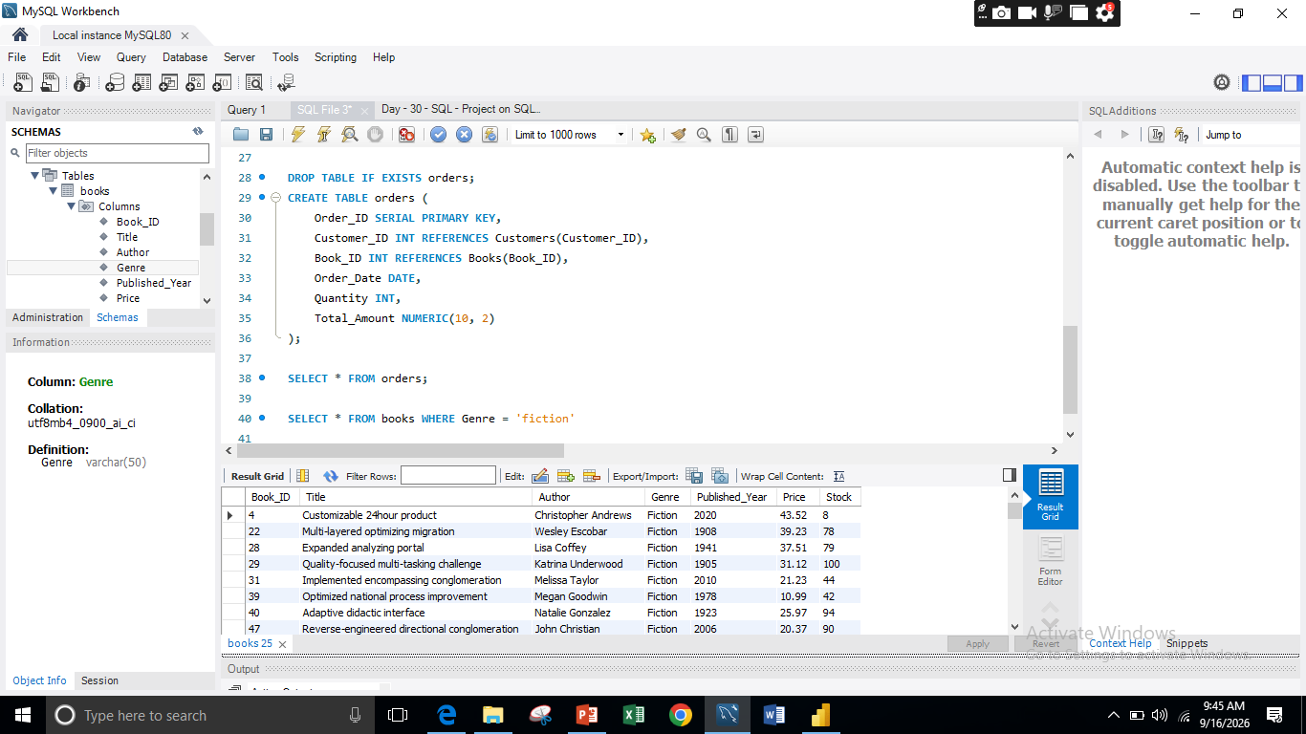
1) Retrieve all books in the "Fiction" genre
Javeria Khalid – Data Analyst

Slide 7
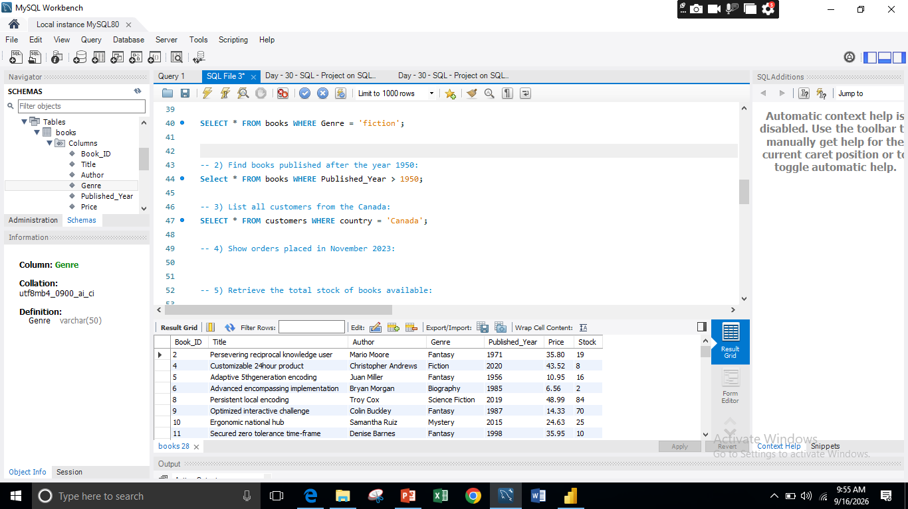
2) Find books published after the year 1950:
Javeria Khalid – Data Analyst

Slide 8
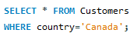
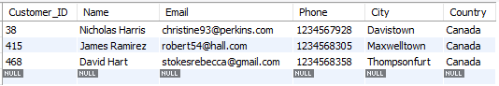
3) List all customers from the Canada:
Javeria Khalid – Data Analyst

Slide 9
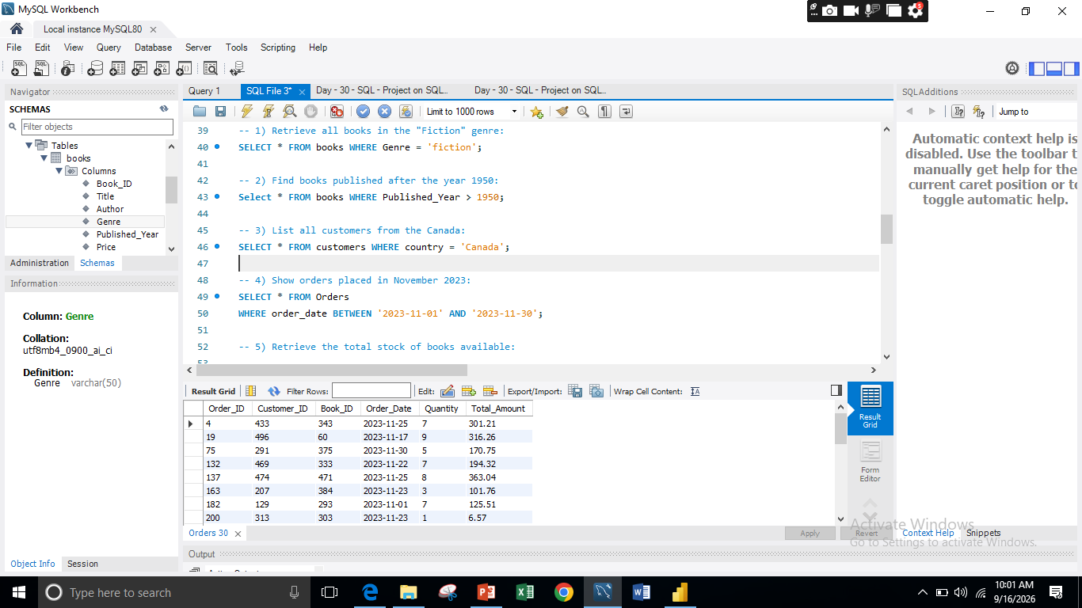
4) Show orders placed in November 2023
Javeria Khalid – Data Analyst

Slide 10
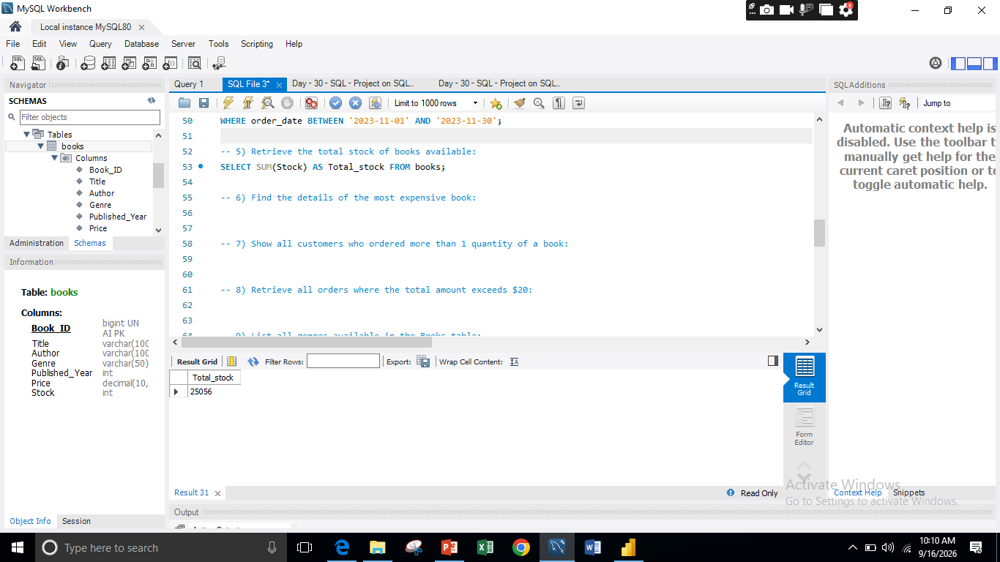
5) Retrieve the total stock of books available:
Javeria Khalid – Data Analyst

Slide 11
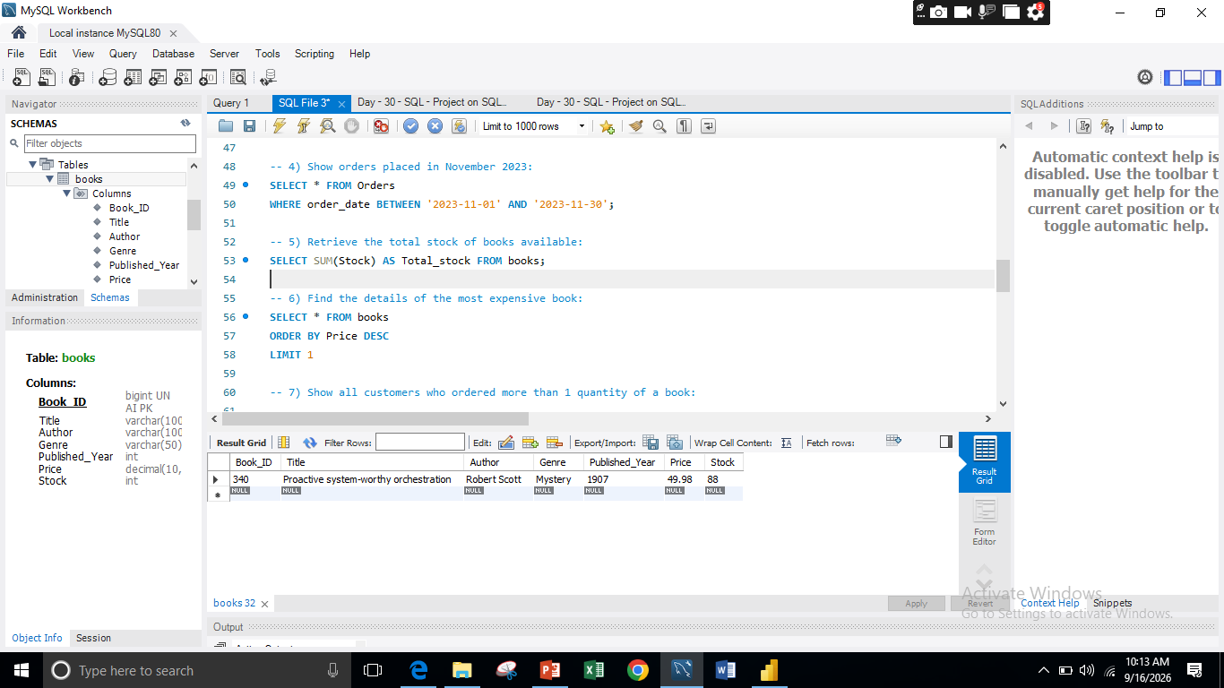
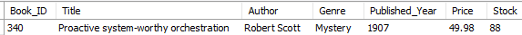
6) Find the details of the most expensive book:
Javeria Khalid – Data Analyst

Slide 12
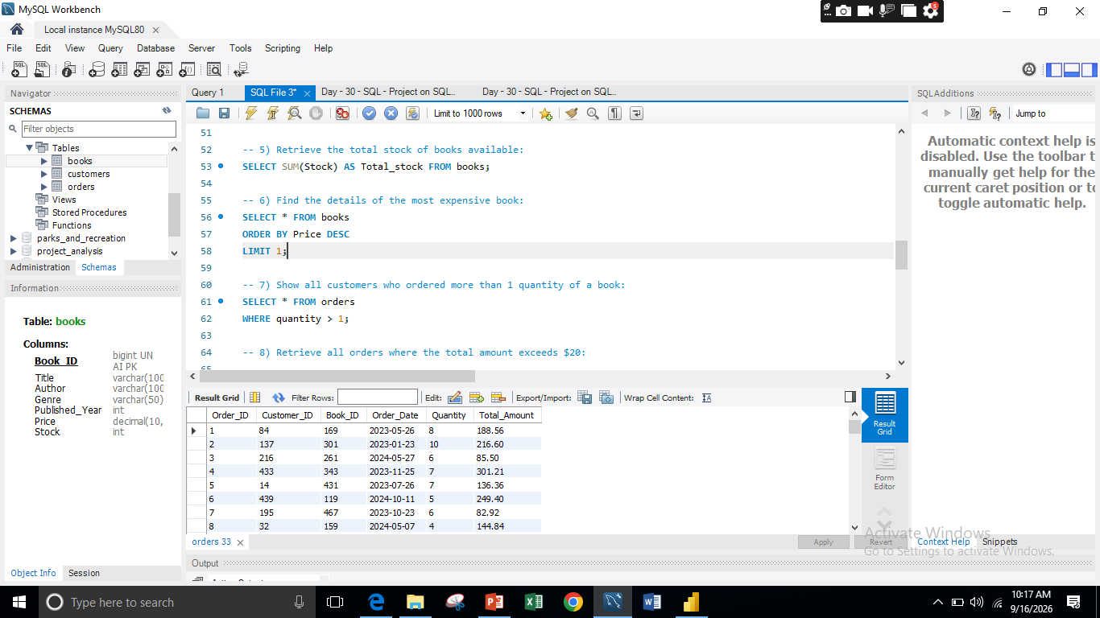
7) Show all customers who ordered more than 1 quantity of a book:
Javeria Khalid – Data Analyst

Slide 13
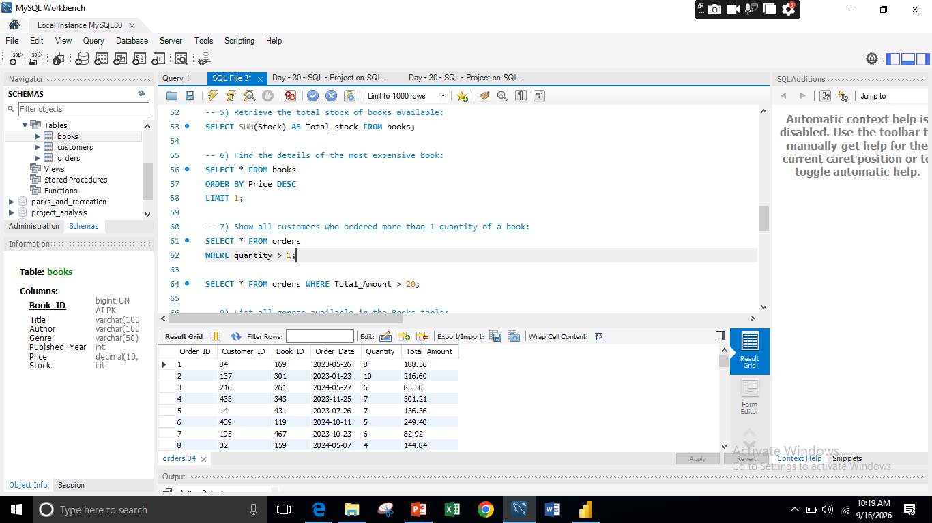
8) Retrieve all orders where the total amount exceeds $20:
Javeria Khalid – Data Analyst

Slide 14
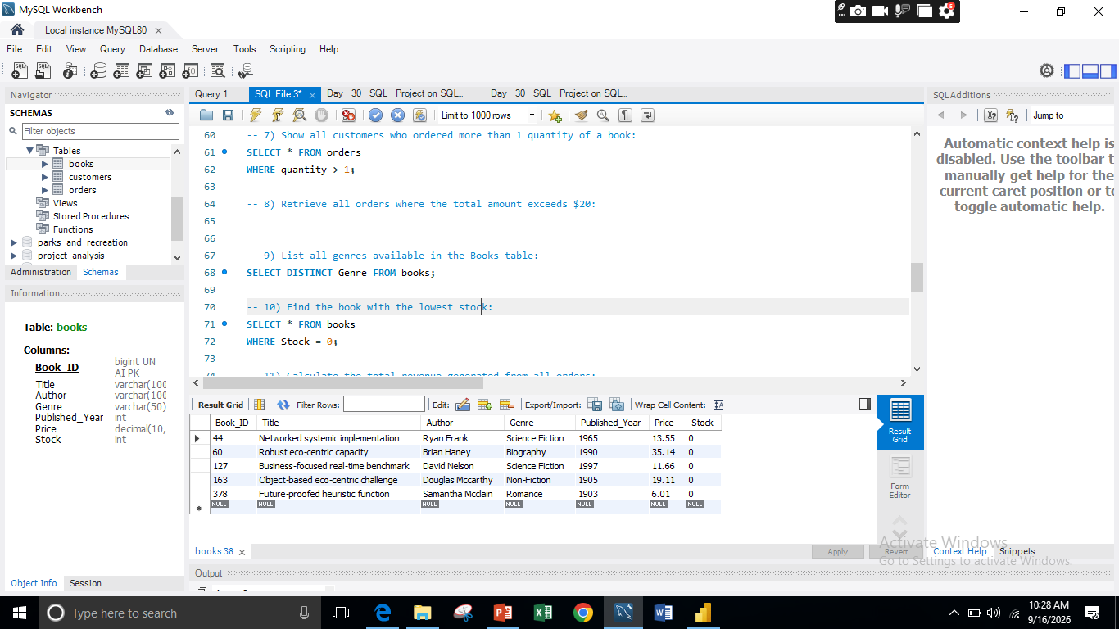
10) Find the book with the lowest stock:
Javeria Khalid – Data Analyst

Slide 15
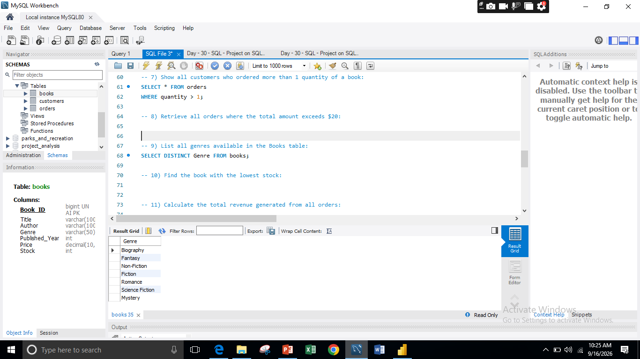
11) List all genres available in the Books table:
Javeria Khalid – Data Analyst

Slide 16
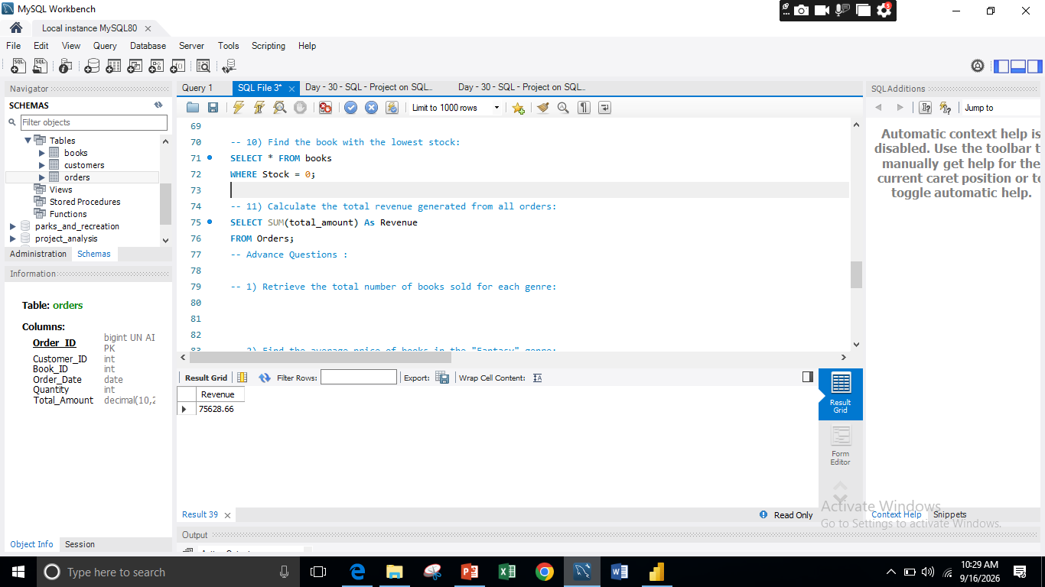
12) Calculate the total revenue generated from all orders:
Javeria Khalid – Data Analyst

Slide 17
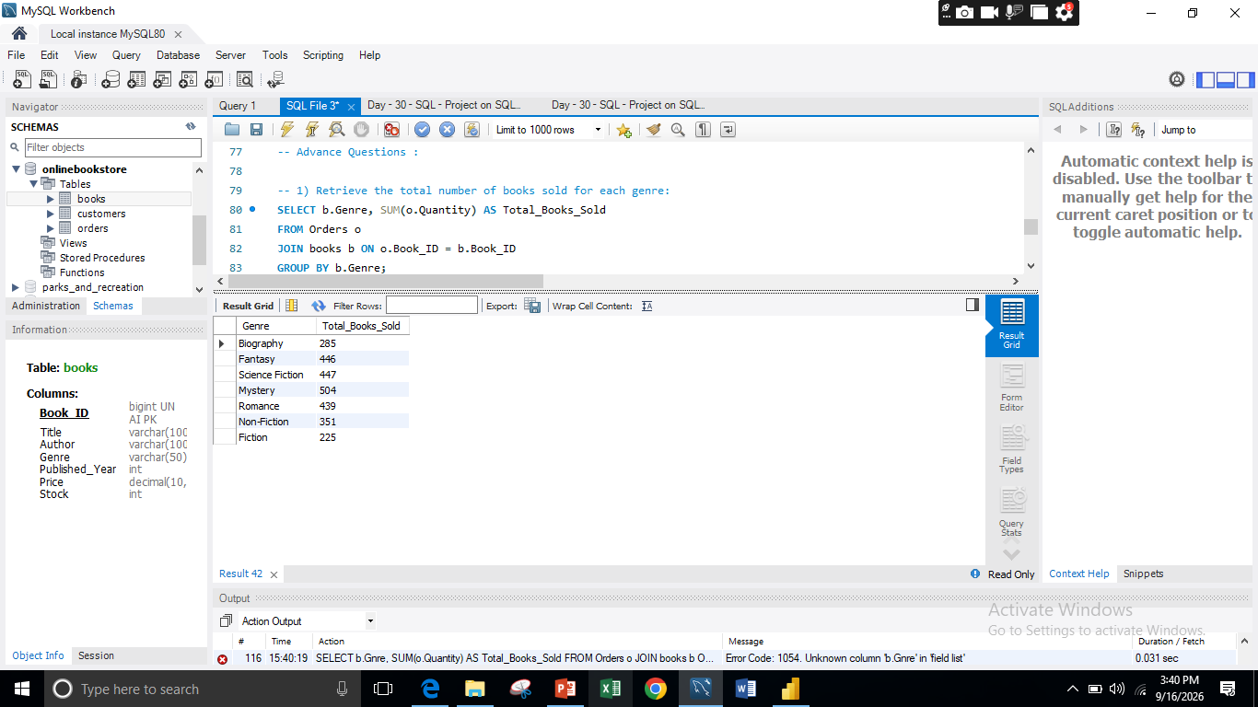
13) R etrieve the total number of books sold for each genre:
Javeria Khalid – Data Analyst

Slide 18
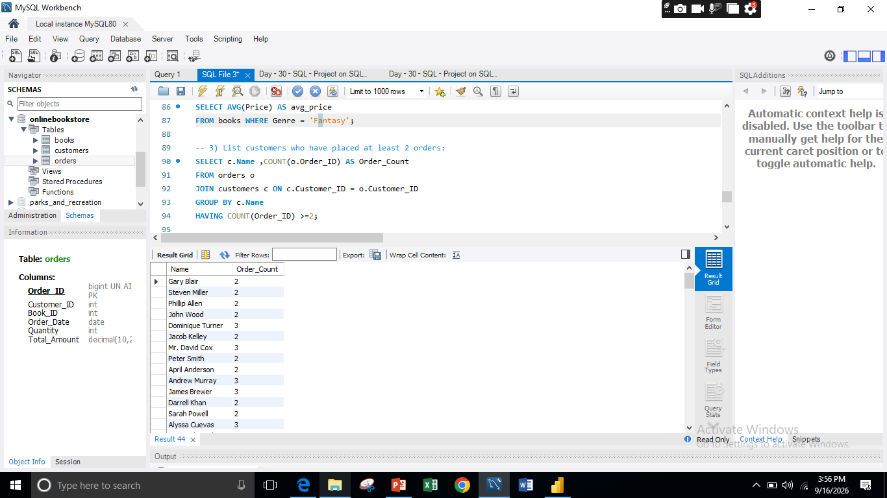
14) Find the average price of books in the "Fantasy" genre:
Javeria Khalid – Data Analyst

Slide 19
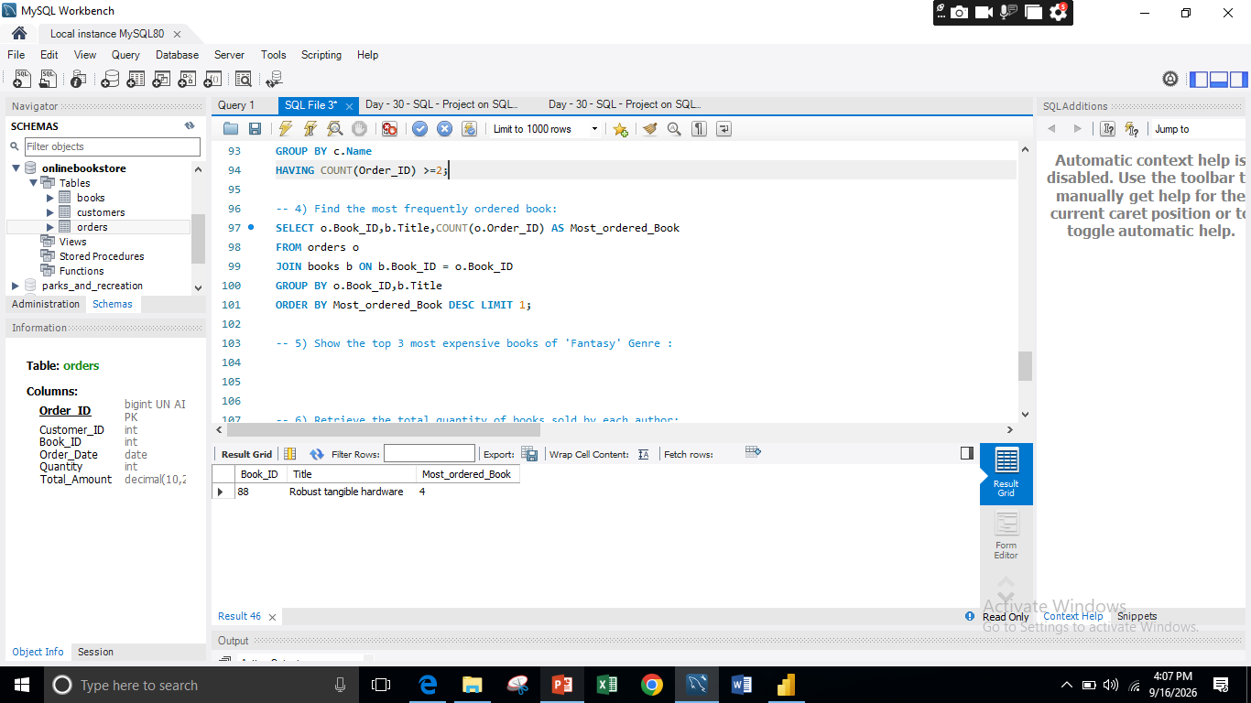
15) Find the most frequently ordered book:
Javeria Khalid – Data Analyst

Slide 20
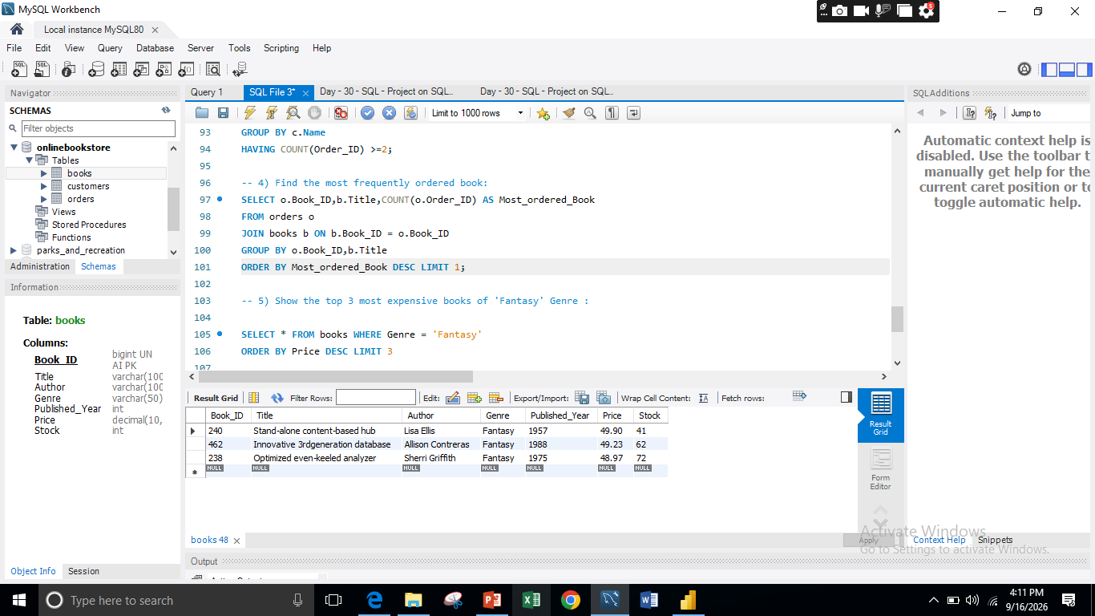
16) Show the top 3 most expensive books of 'Fantasy' Genre :
Javeria Khalid – Data Analyst

Slide 21
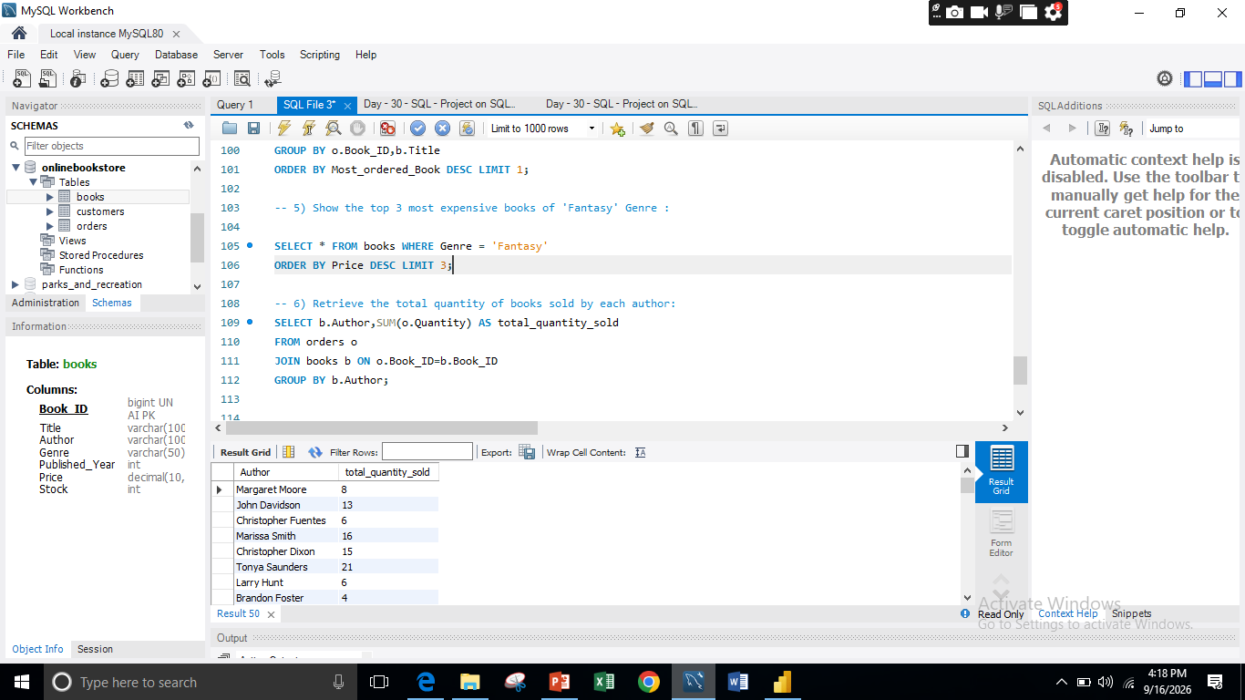
16) Retrieve the total quantity of books sold by each author::
Javeria Khalid – Data Analyst

Slide 22
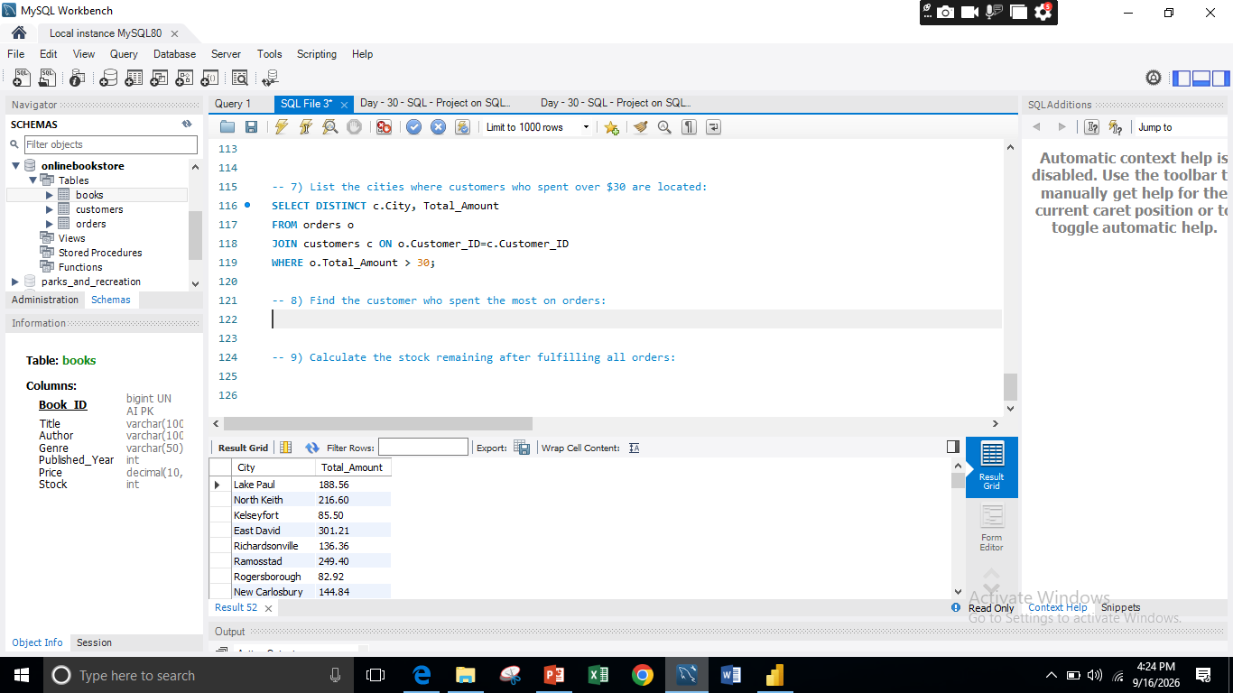
16) List the cities where customers who spent over $30 are located:
Javeria Khalid – Data Analyst

Slide 23
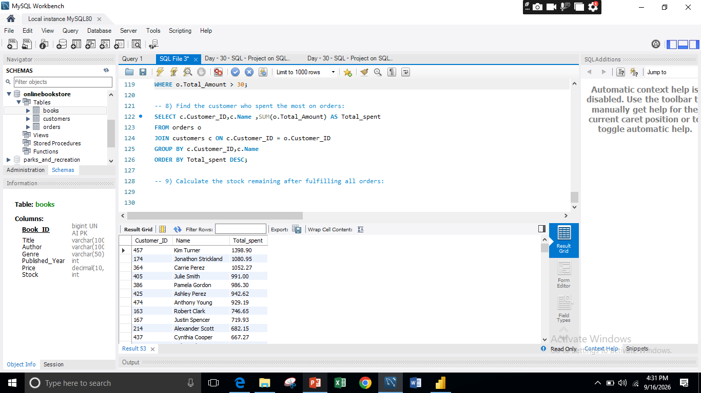
17) Find the customer who spent the most on orders:
Javeria Khalid – Data Analyst

Slide 24
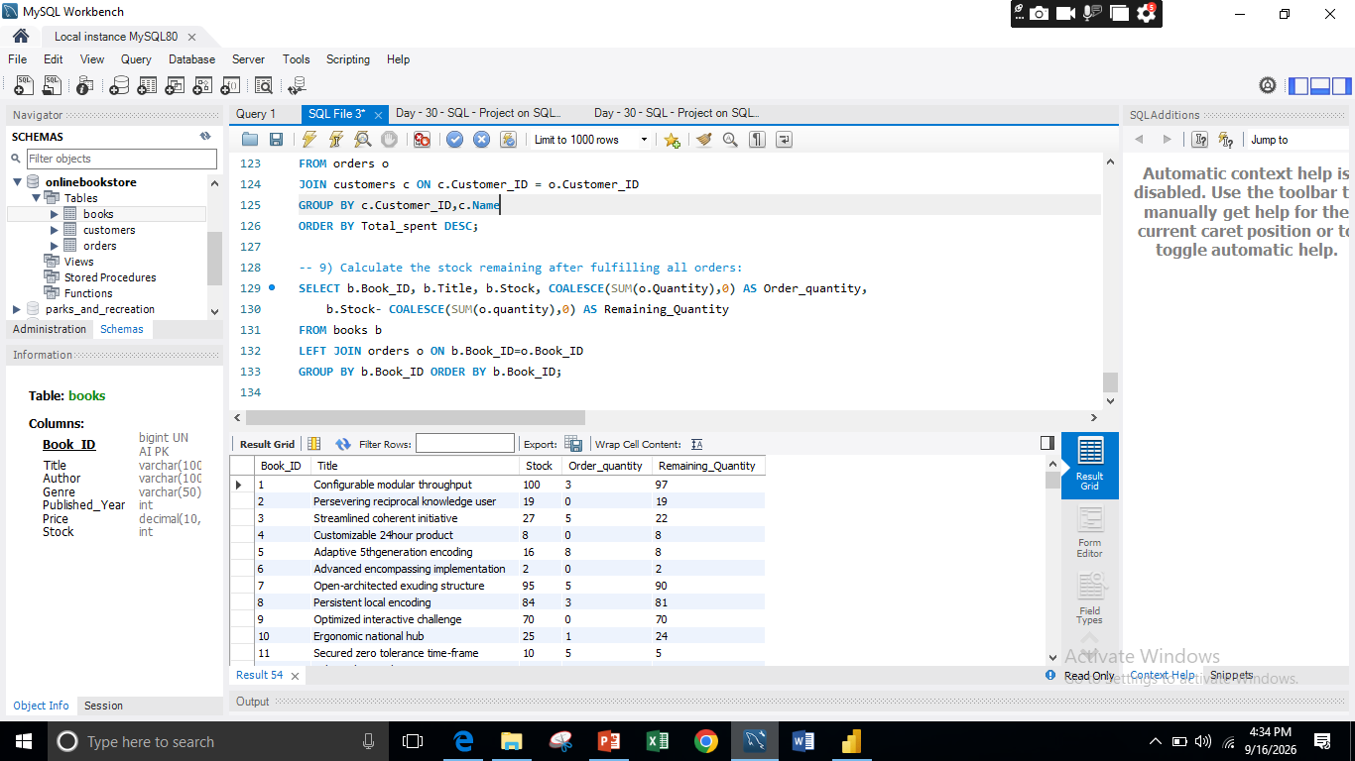
18) Calculate the stock remaining after fulfilling all orders:
Javeria Khalid – Data Analyst

Slide 25
Thank you

